Slide 1
Control Statements in C

Slide 2
Control Statements
To decide what should be the flow of the execution of the program.
To execute bunch of statements from code.
C provides three styles of flow control :
Selection
Branching
Iteration/Looping

Slide 3
Selection Statements
By using these statements ,we can choose one branch or another.
Following are the different Selection statements :
if
if else
else if ladder

Slide 4
if Statement
Most simple form of the branching statements.
If the expression is true then the statement or block of -
Syntax :
if(condition)
{
Block of Statements
}
statements gets executed otherwise these statements are skipped.

Slide 5
if else Statement
If the condition evaluates to true, then the if block of code will be executed, otherwise else block of code will execute.
Syntax :
if(condition)
{
Block of if Statements
}
else
{
Block of else Statements
}

Slide 6
else if ladder statement
An if statement can be followed by an optional else if...else statement, which is very useful to test various conditions.
Syntax : if(condition 1)
{
Block of if Statements
}
else if(condition 2)
{
Block of else if-1 Statements
}
else if(condition 3)
{
Block of else if-2 Statements
}
else
{
Block of else Statements
}

Slide 7
Branching Statement-switch case
If a programmer has to choose one among many alternatives if...else can be used but, this makes programming logic complex.
In switch...case, expression is either an integer or a character
If the value of switch expression matches any of the constant in case, the relevant codes are executed and control moves out of the switch case statement.
If the expression doesn't matches any of the constant in case, then the default statement is executed.
Syntax : switch (expression)
{
case constant1:
break;
case constant2
break;
. . .
default:
break; }

Slide 8
Iterative/Looping Statements
Loops are used in performing repetitive work in programming.
There are 3 types of loops :
while loop
do while loop
for loop

Slide 9
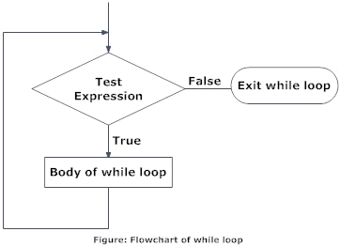
While Loop
Syntax : Initialization; while (condition) { statements to be executed. Increment/ decrement; }

Slide 10
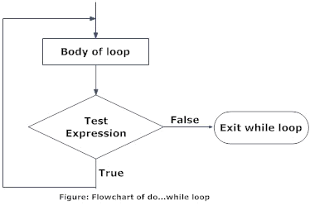
Do-While Loop
Syntax : Initialization; do { some code/s; Increment/ decrement; }while (condition);

Slide 11
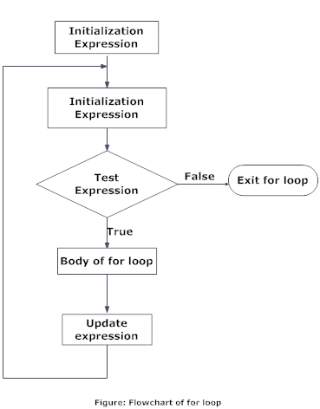
For Loop
Syntax : for(initialization ; condition ; incre/ decre) { code/s to be executed; }

Slide 12
Objectives
At the end of this session you will understand :
Need of Control Statements
Selection(if, if-else, else if ladder)
Branching(switch case)
Looping(While, do while, for)
Notes:
Summarize presentation content by restating the important points from the lessons.
What do you want the audience to remember when they leave your presentation?
Save your presentation to a video for easy distribution (To create a video, click the File tab, and then click Share. Under File Types, click Create a Video.)

